Slide 1
Collaborative Workshop
ESA Copernicus Data Access Update
Razvan Cosac
Prague
11/10/2022

Slide 2
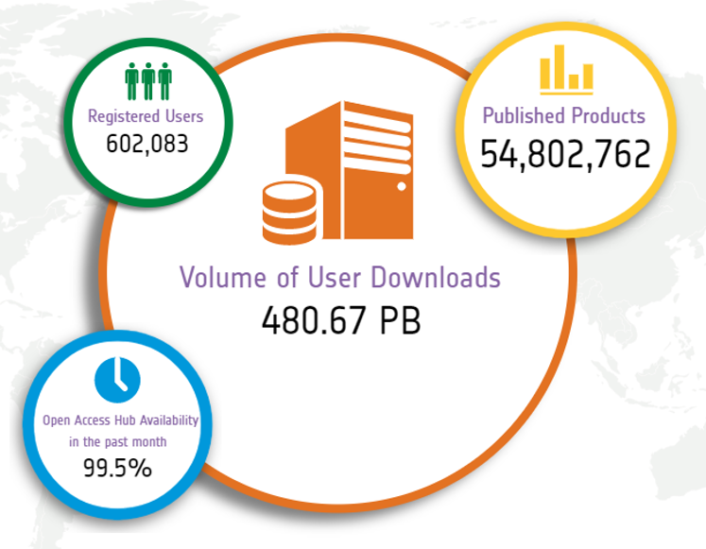
Data Access Service – Key Element
Data Access Services: key and critical element of the Copernicus Space Component
Front-end service that provides free and open access to Copernicus Sentinel User Level Data to various user communities
One of the largest distributors of Earth Observation data worldwide

Slide 3
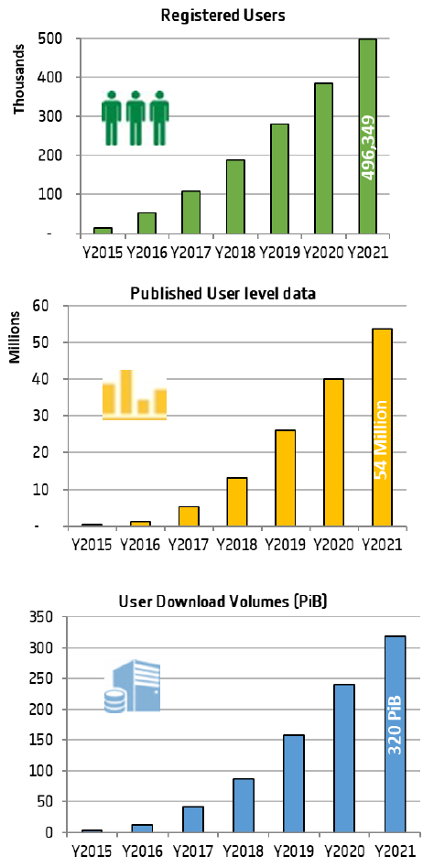
Data Access Service – Statistics
8 years
of Data Access Service operations
>600,000
Total Registered Users
Growth in numbers of active users
>54,000,000
Total Published User Level Data
185.7 million
480 PB
Downloads in 2021
Total Volume Downloaded since start of operations
79.7 PiB
25% of the total downloaded volume
Notes:
We can observe an increase not only in the number of registered users, but also in the number of active users (users which have fully downloaded at least a product over the period of 1 month).
These statistics do not include the downloads from the DIAS Hub, as the DIAS partners systematically download the full collection of user-level data.

Slide 4
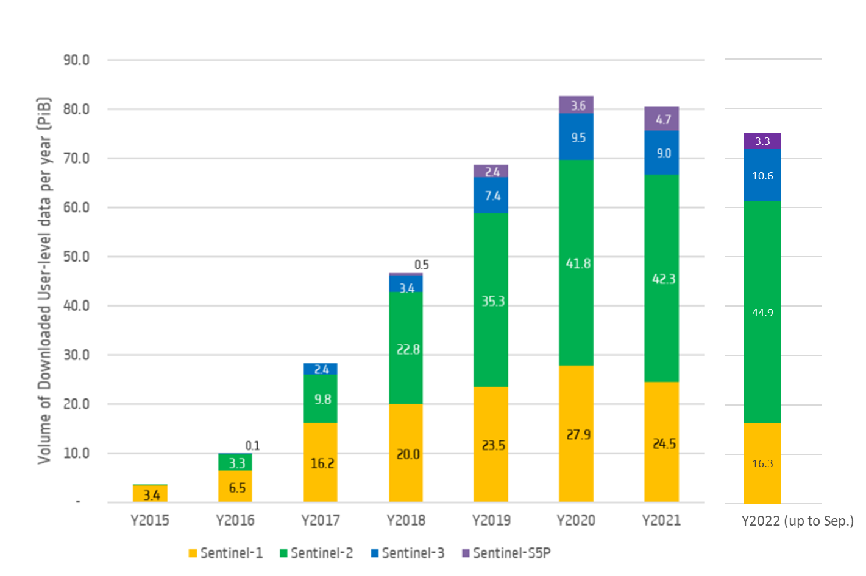
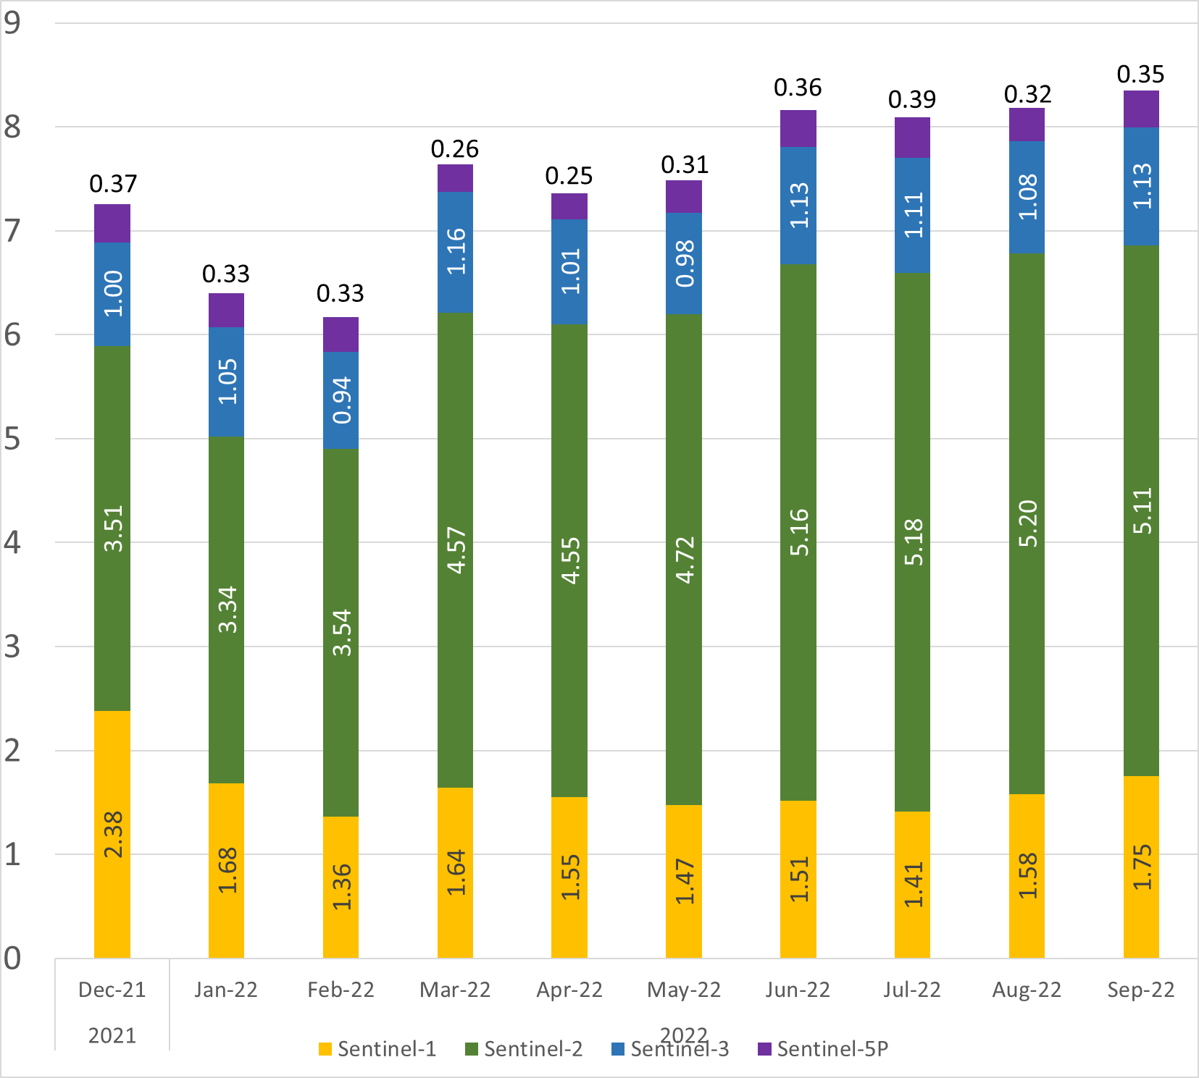
User Level Data Downloads
Volumes of Downloaded User Level Data per year
Volumes of Downloaded User Level Data per month
PiB
Notes:
We can observe in general a slight decrease in the statistics due to the unavailability of S1B data (this is noticeable from Dec-2021 to January and February).
However, we can also see and overall increase in interest for Sentinel-2, both across the years and with the seasonal variability starting from spring and going into the summer.

Slide 5
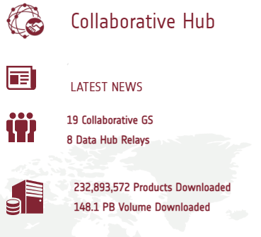
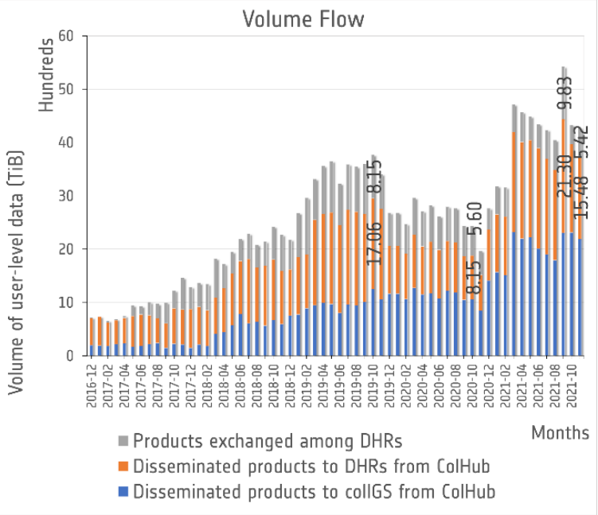
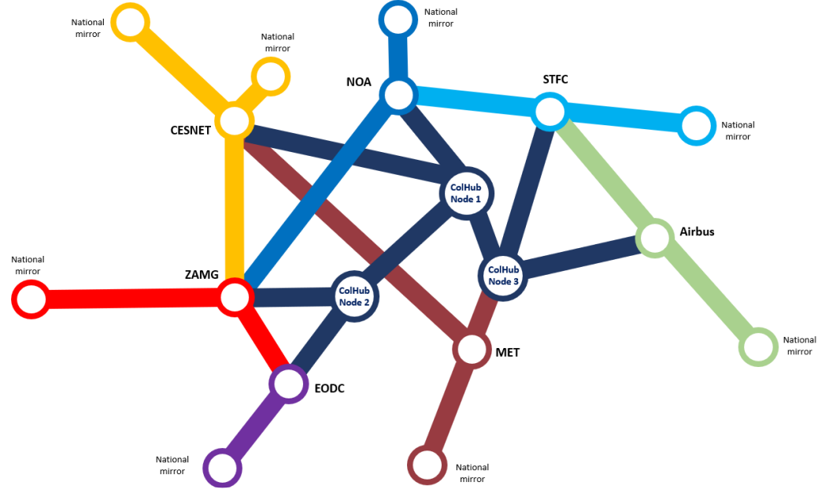
Collaborative Service

Slide 6
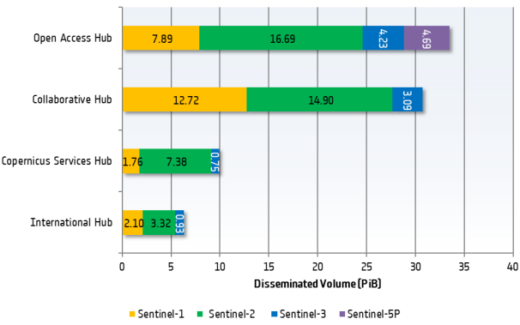
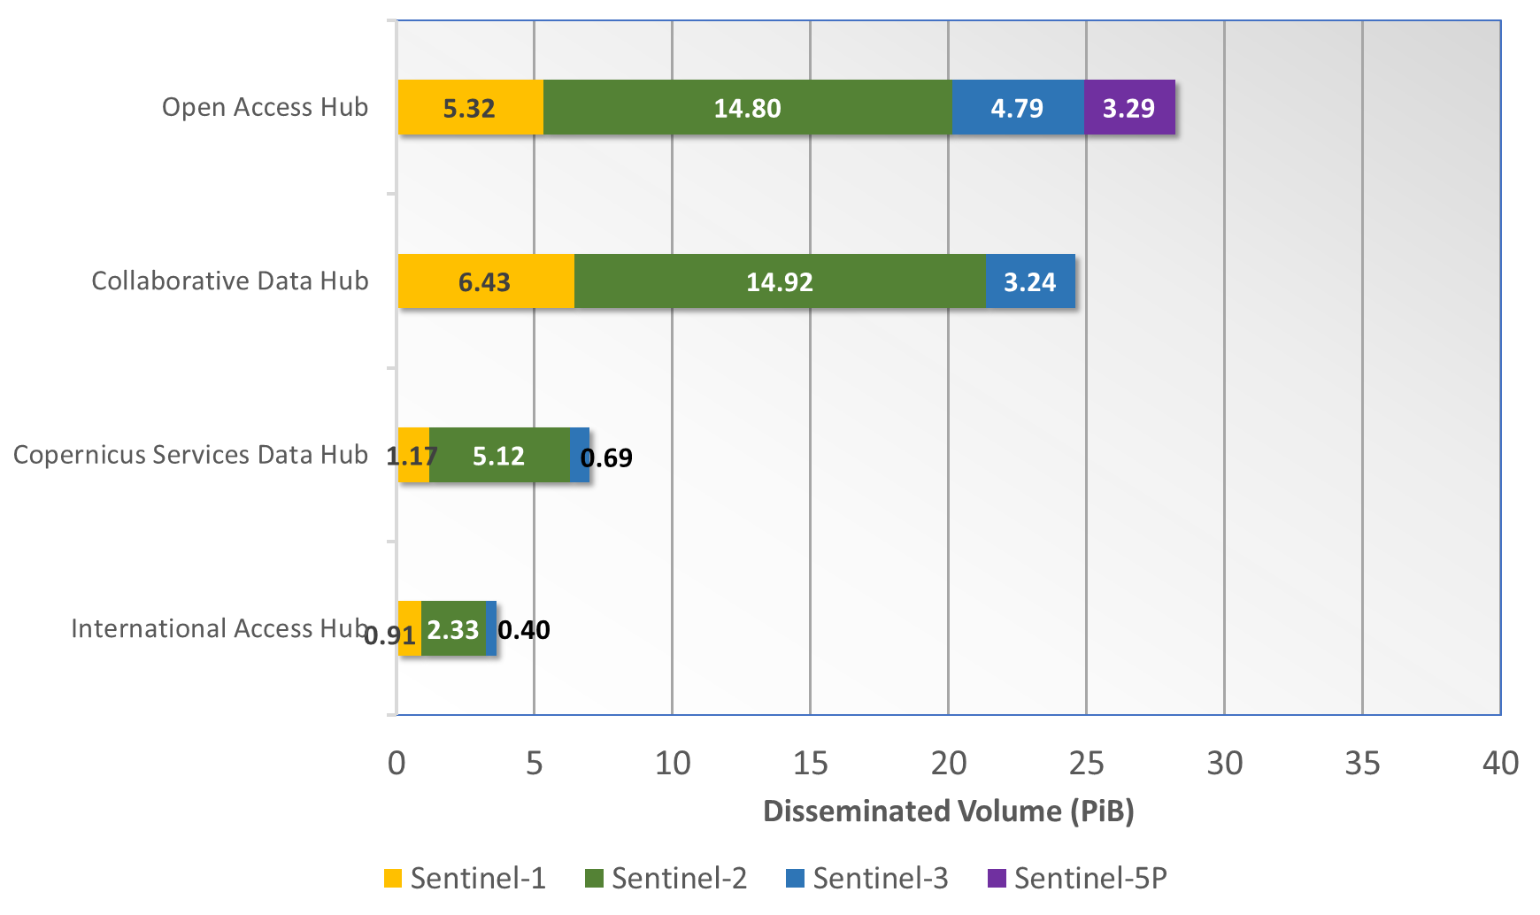
Data distribution highlights
Year 2021
Year 2022 (up to September)
Notes:
Compared to 2021 downloads from the Collaborative Hub took over the downloads from Open Access for what concerns Sentinel-2.

Slide 7

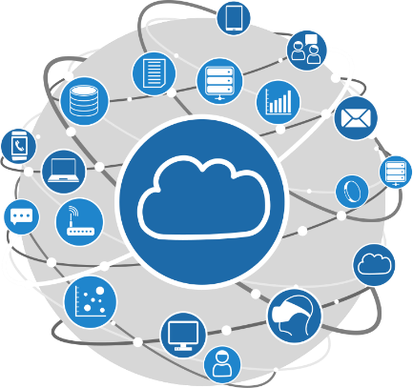
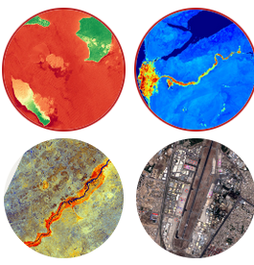

CSC Data Access Service Scope Highlights
Open Ecosystem on a public cloud
Cloud infrastructure services (storage, network and processing resources on the cloud) for user data processing and third-party applications and services, offering users a data exploitation environment
Unified User Management opening access to complementary services such as IaaS, PaaS or SaaS based on the same digital identity
Copernicus Data Access Service
Copernicus data availability & retrieval
(Sentinels User Level Data and CCM data available for download and accessible directly using the IaaS/PaaS services)
Applications, services, documentation and software repository available for re-use by third-party users to facilitate the deployment of their own services within the Copernicus Data Space
Marketplace and support to Third-Party services

Slide 8



CSC Data Access Service – Main Services
Data Discovery and Retrieval
Streamlined Data Access
Open and Free Access to ALL Sentinel User Level Data and Copernicus Contributing Missions Core Data Sets for download and direct access using IaaS resources.
Large data set available for immediate access
Catalogue, View, Discovery
APIs + GUI
Open and free Harmonised access to specific Sentinel Data collections, allowing efficient temporal and spatial access via dedicated API (e.g. OpenEO).
Streamlined data representation and organisation including necessary data transformations (e.g. resampling, tiling using a common reference grid).
Streamlined Data Access
Data Discovery and Retrieval
Unified User Management
Copernicus Data Space
Data Access Service
Traceability Service
On-Demand Production Service
Allowing registration, access and verification of traces for the Copernicus Sentinel and Copernicus Contributing Mission data.
On-Demand Production
Open and free access to on-demand Sentinel-1/2/3 L1 and L2 User Level Data.
Use of operational processors as ESA CFI.
Traceability Service
Open to the entire Ecosystem for trace registration and verification (e.g. free use by other ESA Ground Segment services).

Slide 9
CSC Data Access Service – Services Portfolio
CSC Data Access – Data Access Services Portfolio [DA-SP]
“Copernicus Data Space - Data Access Services Portfolio”
[CDS-SP]
Reference for Service Operations
ITT minimum requirements for the Services Portfolio:
Requested mandatory data offer
Minimum operational sizing and minimum data access configuration performance
  Copernicus Data Access Service Operational Services Portfolio:
  Enriched data and services offer
  Scalable operational capacity and performance configuration, according to a Cost Model
Notes:
CDS-SP: ystem sized for agreed capacity, ESA monitors resource consumption, capability to increase fair-use this according to the available budget

Slide 10
Collaborative GS Continuity
Copernicus Data Access Service
(ColHub 1,2,3)
Copernicus Data Access Service Continuity
Collaborative Hub Node 2 (OVH)
Collaborative Hub Node 3 (GRNET)
Col Hub Node 1 migration to
New C-DAS
Collaborative Hub Node 1 operations on New C-DAS
New Copernicus Data Access Service (C-DAS)
2022
2023
2024
2025
2026
DHuS Maintenance
Notes:
Following the end of the Collaborative Hub there will be an extension for the support of the ColGS to provide access to Sentinel data through the new C-DAS, as well as through the complementary centers in Greece and OVH, including the maintenance of DHuS, until the end of 2024.

Slide 11
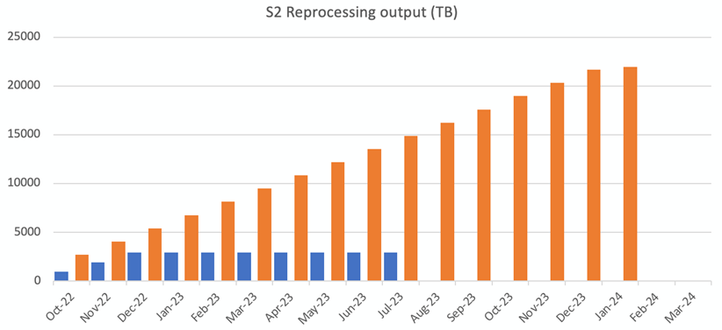
S2 Reprocessed Data Access Timeline
Sentinel-2 Reprocessing is planned to be completed in approx. 9 months.
Publication of the complete reprocessed L1C & L2A data is expected to continue for about 6 additional months.
Total L1C & L2A data reprocessed > 20PB

Slide 12
S2 Reprocessed Data Features
Sentinel-2 reprocessed data is aligned with the current Sentinel-2 operational baseline, with some additional enhancements, in particular:
        All data will be reprocessed with the Copernicus 30m DEM
Information on the status of reprocessing and available reprocessed data will be regularly published online

Slide 13
S2 Reprocessed Data Access Timeline
Sentinel-2 Reprocessing Service
S2 RPRO PRIPs
DHuS
Copernicus Data Access Service (Datahub)
Col
Hub
Migration of Collaborative Hub Node 1 to
New Copernicus Data Access Service (C-DAS)
New Copernicus Data Access Service (C-DAS)
Collaborative Hub Node 1
DHuS
Collaborative GS
2023
Oct
Nov
Dec
Jan
Feb
Mar
Apr
May
Jun
Jul
Aug
Sept
Oct
Notes:
S2 reprocessed data will be made available to interested Collaborative GS partners through a dedicated DHuS instance from the DataHub. Next year then plan is to move the Collaborative Hub Node 1 to the new C-DAS and the reprocessed data will be available through that access point, keeping a DHuS instance on the new Data Access infrastructure.

Slide 14
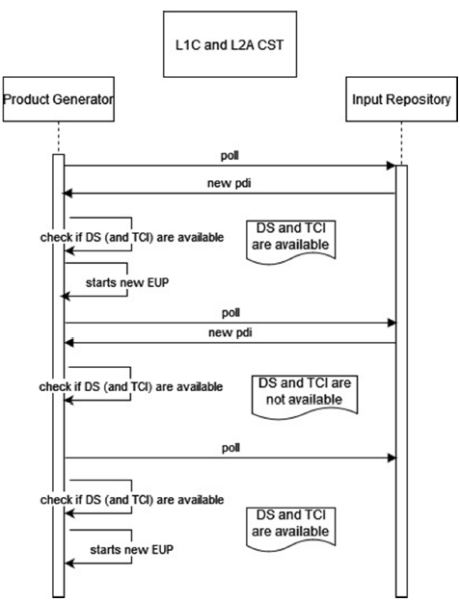
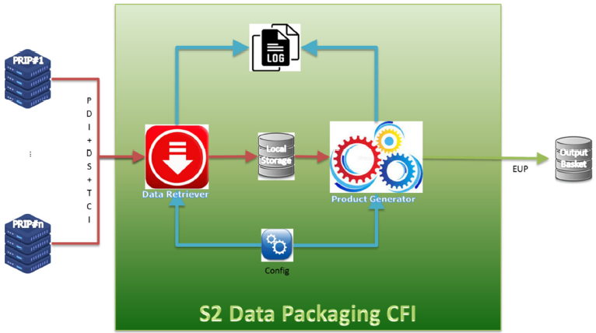
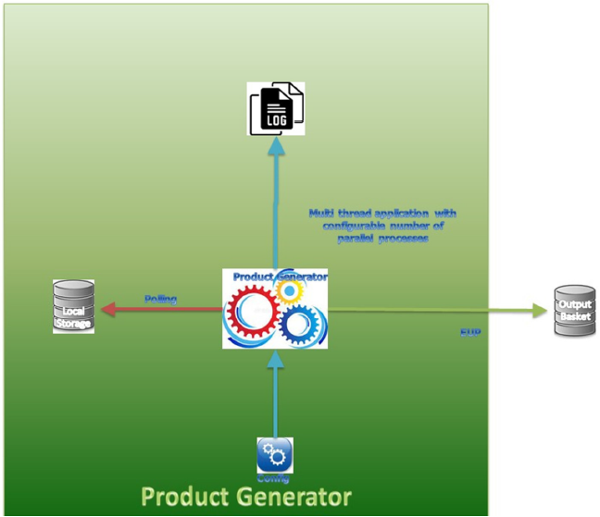
Sentinel-2 Data Packaging CFI
Generating EUP from the PDIs present in a directory, according to the options defined, which include at least:
  Bands selection
  Aggregation along track (L1A/L1B)
  Tile consolidation (L1C/L2A)
  Output format (Compact, SAFE)
  Single Tile and Complete Single Tile
S2 Data Packaging CFI can be made available to the Collaborative partners that are interested in generating their own product packages.
Generation of Traces through the Traceability Service is mandatory.
Notes:
Data Packaging CFI is capable of generating Sentinel-2 Final Format Data from the Sentinel-2 PDIs.
In its current state it consist of two main components a Data Retriever and a Product Generator.
The product generator does not have a GUI. The status of product generation can be monitored via a log file.
Various options for EUP generation can be configured through command line
S2 Data Packaging CFI can be made available to the Collaborative partners that are interested in generating their own product packages (incl. generation of Traces through the Traceability Service – those who use the CFI shall generate traces)

