Slide 1
Terrascope
ESA CollGS Workshop 11 Oct 2022
Dennis Clarijs

Slide 2
Terrascope
Belgian CollGS agreement signed Sept 2017 with BELSPO
VITO is designated entity in Belgium
Platform released from March 2018 onwards
Onboarded in Network of Resources in 2020

Slide 3
Terrascope Mission
Focus on Analysis Ready Data (ARD)
Preprocessed added value products & analysis tools
On-demand datasets
Converted to COG format and INSPIRE metadata compliancy
Unique long term global vegetation datasets
Strong BE user focus
Services, cloud processing to enable users to build upon
Road shows, user onboarding, tutorials, webinars, MOOC
Project support activities
Federated node in EU infrastructure

Slide 4
Terrascope available datasets
Native datasets (COG format)
Sentinel-1
Benelux area
Full archive
GRD; GRD-0
SLC; Coherence
Sentinel-2
Europe/selected regions
Full archive for Benelux
2Y rolling archive for EU
L2A TOC
Vegetation indices
Water indices
Sentinel-3
Global
Full archive
SYN-VGT
Sentinel-5p
Global
2018 - present
NO2
CO
(HCHO)
(CH4)

Slide 5
Terrascope available datasets
Native datasets
PROBA-V
Global
Full archive
SPOT VEGETATION
Global
Full archive
Copernicus Services
Global
Full archive
LAI
FAPAR
DEM
30m
90m
ESA World Cover
Global
2020
2021 (October 2022)

Slide 6
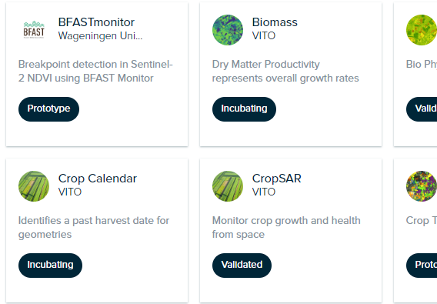
Terrascope interfaces
Update 2022
Terraviewer
Novice users
Viewing
Comparing
Time lapses
Downloads
Time series analysis
Virtual Machines
Expert users
NFS File access
Wide Open-source toolset
Access to HPC
Jupyter Notebooks
Expert users
Use Python/R/Scala
Access to HPC
Web Services
Expert users
WMS/WMTS/WCS
OpenSearch Catalogue
(STAC Catalogue)
OpenEO API
EOplaza
Expert users
On demand algorithm execution
Orchestration on OpenEO or ASB
3rd party service publication possible
Credit system
Notes:
Identity mgmt using own keycloack, but integrates with commercial identity providers (SoM) and EGI (EOSC)

Slide 7
Terrascope in a federated EU ecosystem
https://fedeo-client.ceos.org/
https://openeo.cloud/
https://eosc-portal.eu/
https://www.sentinel-hub.com/
https://www.wasdi.cloud/

Slide 8
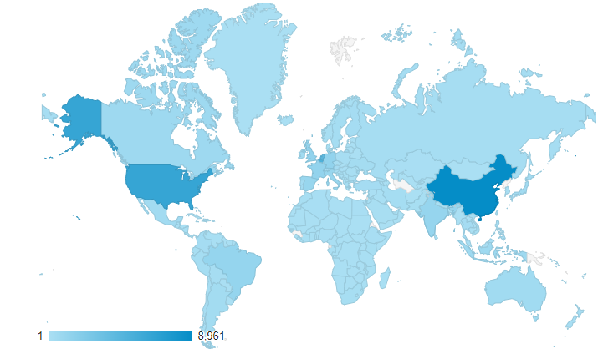
Terrascope Statistics
Ondertitel
Platform visitors: 40000+
Registered active users: 8000+
Nationalities: 173
Unique datasets: 32
Online data capacity: 7.5 PB
VM usage: +-300

Slide 9
What the future holds
Short term:
Sentinel-5P HCHO, CH4, SO2 composite products
ESA World Cover 2021 update
Framework agreement negotiation with BELSPO:
Optimal use of future Copernicus Data Access Space to extend coverage and services to users
Support to BE Climate Center initiative
Support to DestinE activities

Slide 10
Thank You
Dennis Clarijs contactpersoon
Dennis.clarijs@vito.be
info@terrascope.be

